Slide 1
Distance Vector Routing
Modern computer networks generally use dynamic routing algorithms
because static algorithms do not take the current network load into account.
Two dynamic algorithms are the most popular
distance vector routing and
link state routing

Slide 2
Routing Algorithms - DVR
Distance Vector Routing (DVR)
Algorithms operate by having each router maintain a table (i.e, a vector) giving the best known distance to each destination and which line to use to get there.
These tables are updated by exchanging information with the neighbors
Other names:
distributed Bellman-Ford routing algorithm
Ford-Fulkerson algorithm
original ARPANET routing algorithm
used in Internet under the name RIP (Routing Information Protocol)

Slide 3
Routing Algorithms - DVR
In DVR, each router maintains a routing table containing one entry for each router in the subnet.
This entry contains two parts:
the preferred outgoing line to use for that destination
an estimate of the time or distance to that destination
The metric used might be
number of hops,
time delay in milliseconds,
total number of packets queued along the path, or
something similar

Slide 4
Routing Algorithms - DVR
The router is assumed to know the ''distance'' to each of its neighbors.
If the metric is hops, the distance is just one hop.
If the metric is queue length, the router simply examines each queue.
If the metric is delay, the router can measure it directly with special ECHO packets that the receiver just timestamps and sends back as fast as it can.
Consider an example, assume that delay is used as a metric and that the router knows the delay to each of its neighbors.
Once every T msec, each router sends to each neighbor a list of its estimated delays to each destination.
It also receives a similar list from each neighbor.

Slide 5
Routing Algorithms - DVR
Imagine that one of these tables has just come in from neighbor X, with X_{i} being X's estimate of how long it takes to get to router i.
If the router knows that the delay to X is m msec, it also knows that it can reach router i via X in X_{i} + m msec.
By performing this calculation for each neighbor, a router can find out which estimate seems the best and use that estimate and the corresponding line in its new routing table
Old routing table is not used in the calculation
This updating process is illustrated in following figure.

Slide 6
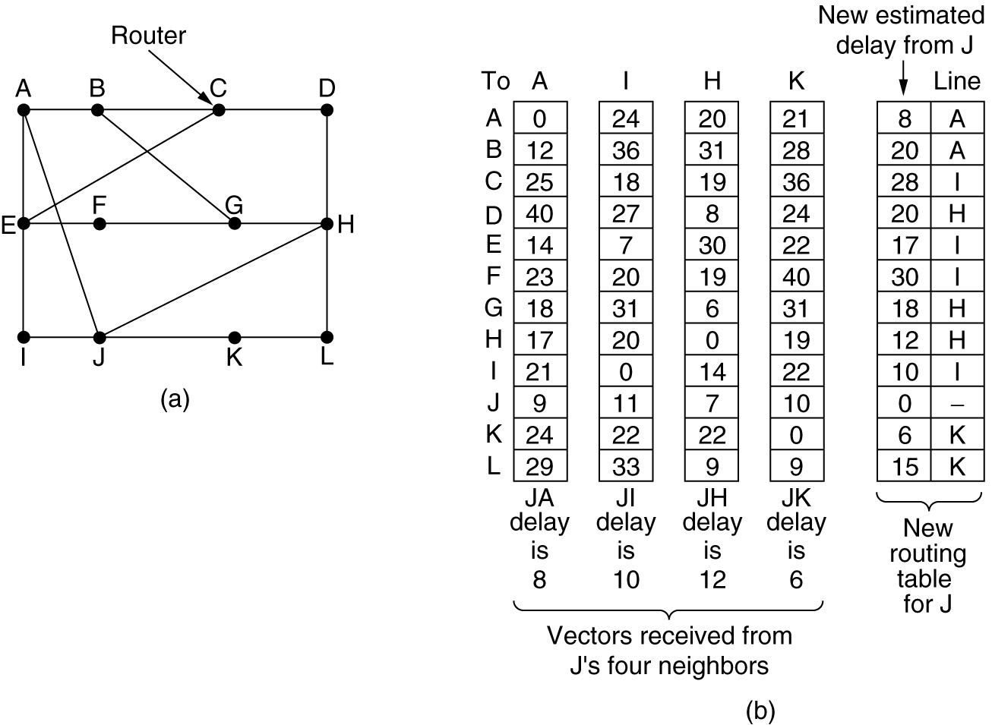
Distance Vector Routing
(a) A subnet. (b) Input from A, I, H, K, and the new routing table for J.

Slide 7
Routing Algorithms - DVR
Suppose that J has measured or estimated its delay to its neighbors, A, I, H, and K as 8, 10, 12, and 6 msec, respectively
Consider how J computes its new route to router G.
It knows that it can get to A in 8 msec, and A claims to be able to get to G in 18 msec, so J knows it can count on a delay of 26 (8+18) msec to G if it forwards packets bound for G to A.
Similarly, it computes the delay to G via I, H, and K as 41 (31 + 10), 18 (6 + 12), and 37 (31 + 6) msec, respectively.
The best of these values is 18, so it makes an entry in its routing table that the delay to G is 18 msec and that the route to use is via H.
The same calculation is performed for all the other destinations, with the new routing table shown in the last column of the figure

Slide 8
Routing Algorithms - DVR
Distance vector routing works in theory but has a serious drawback in practice:
although it converges to the correct answer, it may do so slowly.
In particular, it reacts rapidly to good news, but leisurely to bad news.
Consider a router whose best route to destination X is large.
If on the next exchange neighbor A suddenly reports a short delay to X, the router just switches over to using the line to A to send traffic to X.
In one vector exchange, the good news is processed.

Slide 9
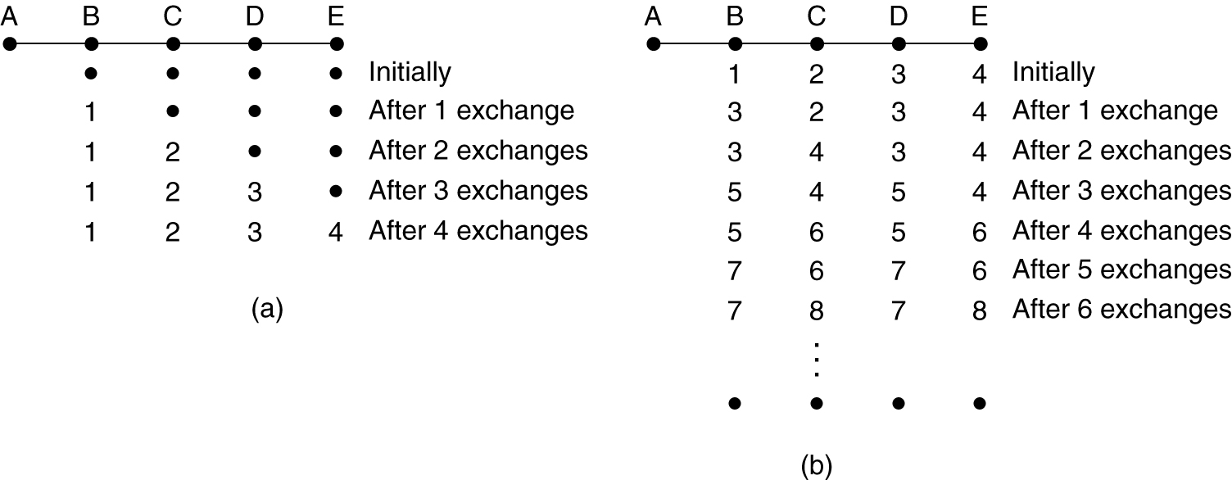
Distance Vector Routing
a) Good news spreads faster

Slide 10
Routing Algorithms - DVR
To see how fast good news propagates, consider the five-node (linear) subnet of Fig. a, where the delay metric is the number of hops.
Suppose A is down initially and all the other routers know this.
In other words, they have all recorded the delay to A as infinity.
When A comes up, the other routers learn about it via the vector exchanges.
Assume periodically a vector exchange has initiated at all routers simultaneously.
At the time of the first exchange, B learns that its left neighbor has zero delay to A.
B now makes an entry in its routing table that A is one hop away to the left.
All the other routers still think that A is down.

Slide 11
Routing Algorithms - DVR
At this point, the routing table entries for A are as shown in the second row of Fig a.
On the next exchange, C learns that B has a path of length 1 to A
so it updates its routing table to indicate a path of length 2
but D and E do not hear the good news.
Clearly, the good news is spreading at the rate of one hop per exchange.
In a subnet whose longest path is of length N hops, within N exchanges everyone will know about newly-revived lines and routers

Slide 12
Distance Vector Routing
b) The count-to-infinity problem.

Slide 13
Routing Algorithms - DVR
Now let us consider the situation of Fig. (b), in which all the lines and routers are initially up.
Routers B, C, D, and E have distances to A of 1, 2, 3, and 4, respectively.
Suddenly A goes down, or the line between A and B is cut
At the first packet exchange, B does not hear anything from A.
Fortunately, C says: I have a path to A of length 2.
B does not know that C's path runs through B itself.
As a result, B thinks it can reach A via C, with a path length of 3.
D and E do not update their entries for A on the first exchange.

Slide 14
Routing Algorithms - DVR
On the second exchange, C notices that each of its neighbors claims to have a path to A of length 3.
It picks one of the them at random and makes its new distance to A 4, as shown in the third row of Fig. (b).
why bad news travels slowly:
no router ever has a value more than one higher than the minimum of all its neighbors.
core of the problem is
when X tells Y that it has a path somewhere, Y has no way of knowing whether it itself is on the path.

Slide 15
Routing Algorithms - LSR
Link State Routing (LSR)
Distance vector routing was used in the ARPANET until 1979
After that, it was replaced by link state routing
Two primary problems caused the failure of DVR.
Since the delay metric was queue length, it did not take line bandwidth into account when choosing routes.
Initially, all the lines were 56 kbps, so line bandwidth was not an issue, but after some lines had been upgraded to 230 kbps and others to 1.544 Mbps, not taking bandwidth into account was a major problem
algorithm often took too long to converge (the count-to-infinity problem)
Variants of link state routing are now widely used.

Slide 16
Routing Algorithms - LSR
Idea behind LSR is simple and can be stated as 5 parts. Each router must do the following
Discover its neighbors & learn their network addresses.
Measure the delay or cost to each of its neighbors.
Construct a packet telling all it has just learned.
Send this packet to all other routers.
Compute the shortest path to every other router.
Learning about the Neighbors
When a router is booted, its first task is to learn who its neighbors are.
It accomplishes this goal by sending a special HELLO packet on each point-to-point line.
The router on the other end is expected to send back a reply telling who it is.
These names must be globally unique

Slide 17
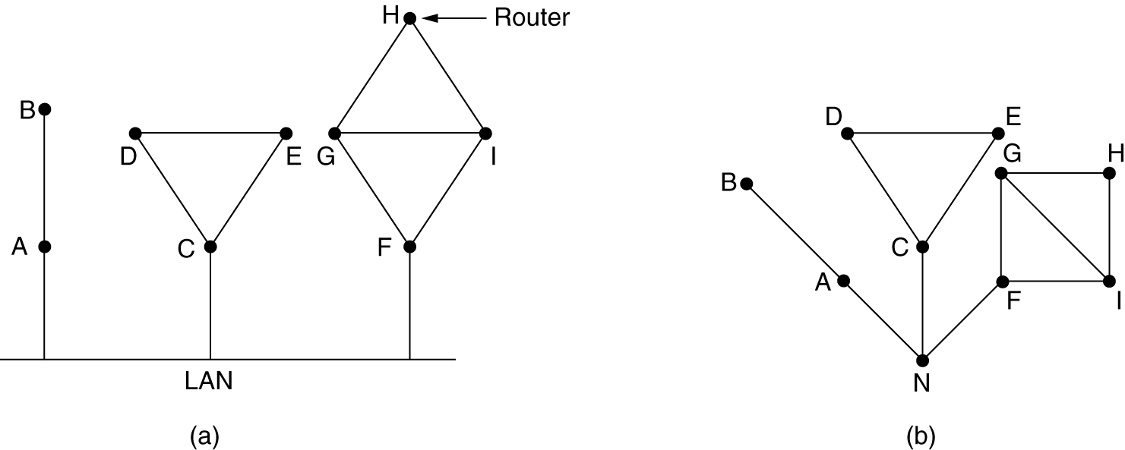
Routing Algorithms - LSR
When two or more routers are connected by a LAN, the situation is slightly more complicated
One way to model the LAN is to consider it as a node itself
(a) Nine routers and a LAN. (b) A graph model of (a).

Slide 18
Routing Algorithms - LSR
Measuring Line Cost
each router must know a reasonable estimate of the delay to each of its neighbors.
The most direct way to determine this delay is to send over the line a special ECHO packet that the other side is required to send back immediately.
By measuring the round-trip time and dividing it by two, the sending router can get a reasonable estimate of the delay.

Slide 19
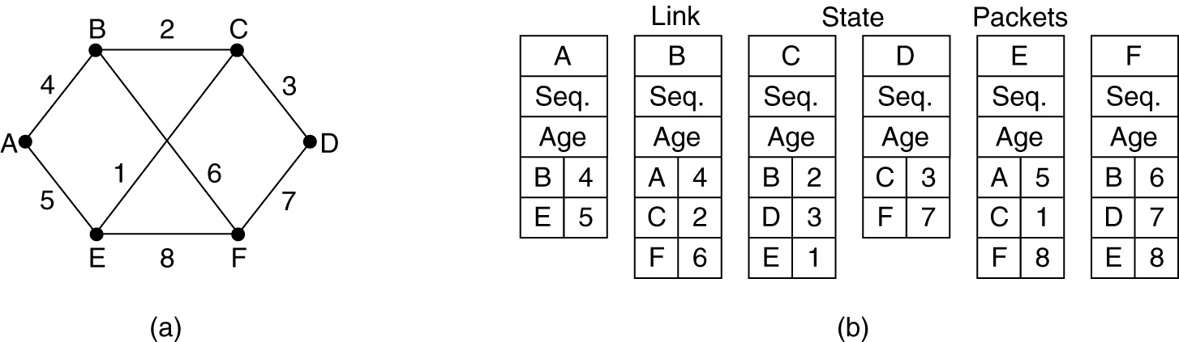
Routing Algorithms - LSR
Building Link State Packets (LSP)
Once the information needed for the exchange has been collected, the next step is for each router to build a packet containing all the data.
The packet starts with the identity of the sender, followed by a sequence number and age and a list of neighbors.
For each neighbor, the delay to that neighbor is given.
(a) A subnet. (b) The link state packets for this subnet.

Slide 20
Routing Algorithms - LSR
Building Link State Packets
Building the link state packets is easy.
The hard part is determining when to build them.
One possibility is to build them periodically, that is, at regular intervals.
Another possibility is to build them when some significant event occurs, such as a line or neighbor going down or coming back up again or changing its properties appreciably.

Slide 21
Routing Algorithms - LSR
Distributing the Link State Packets
link state packets are to be distributed reliably
As the packets are distributed and installed, the routers getting the first ones will change their routes.
Consequently, the different routers may be using different versions of the topology,
This can lead to inconsistencies, loops, unreachable machines, and other problems.
basic distribution algorithm
fundamental idea is to use flooding to distribute the link state packets
To keep the flood in check, each packet contains a sequence number that is incremented for each new packet sent.
Routers keep track of all the (source router, sequence) pairs they see.

Slide 22
Routing Algorithms - LSR
Distributing the Link State Packets
When a new link state packet comes in, it is checked against the list of packets already seen.
If it is new, it is forwarded on all lines except the one it arrived on.
If it is a duplicate, it is discarded.
If a packet with a sequence number lower than the highest one seen so far ever arrives, it is rejected as being obsolete since the router has more recent data.
This algorithm has a few problems, but they are manageable
Problem 1: if the sequence numbers wrap around, confusion will happen.
solution is to use a 32-bit sequence number.
With one link state packet per second, it would take 137 years to wrap around, so this possibility can be ignored.

Slide 23
Routing Algorithms - LSR
Distributing the Link State Packets
Problem 2: if a router ever crashes, it will lose track of its sequence number.
If it starts again at 0, the next packet will be rejected as a duplicate
Problem 3: if a sequence number is ever corrupted and 65,540 (1000 0000 0000 0100) is received instead of 4 (0000 0000 0000 0100) (a 1-bit error), packets 5 through 65,540 will be rejected as obsolete, since the current sequence number is thought to be 65,540.
Solution to all these problems is to include the age of each packet after the sequence number and decrement it once per second.
When the age hits zero, the information from that router is discarded.

Slide 24
Routing Algorithms - LSR
Distributing the Link State Packets
Some refinements to this algorithm make it more robust.
When a link state packet comes in to a router for flooding, it is not queued for transmission immediately.
Instead it is first put in a holding area to wait a short while.
If another link state packet from the same source comes in before the first packet is transmitted, their sequence numbers are compared.
If they are equal, the duplicate is discarded.
If they are different, the older one is thrown out.
To guard against errors on the router-router lines, all link state packets are acknowledged.
When a line goes idle, the holding area is scanned in round-robin order to select a packet or acknowledgement to send.

Slide 25
Routing Algorithms - LSR
Computing the New Routes
Once a router has accumulated a full set of link state packets, it can construct the entire subnet graph because every link is represented.
Every link is represented twice, once for each direction.
The two values can be averaged or used separately.
Dijkstra's algorithm can be run locally to construct the shortest path to all possible destinations.
The results of this algorithm can be installed in the routing tables, and normal operation resumed.
For a subnet with n routers, each of which has k neighbors, the memory required to store the input data is proportional to kn.
For large subnets, this can be a problem.
Also, the computation time can be an issue.
but, in many practical situations, link state routing works well.

Slide 26
Routing Algorithms - LSR
Link state routing is widely used in actual networks like
OSPF (Open shortest Path First) protocol, which is widely used in the Internet
IS-IS (Intermediate System-Intermediate System), which was designed for DECnet (Digital Equipment Corporation Network) and later adopted by ISO for use with its connectionless network layer protocol, CLNP
used in some Internet backbones and in some digital cellular systems

Slide 27
Routing Algorithms - OSPF
OSPF - The Interior Gateway Routing Protocol
Routing in the Internet
Internet is made up of a large number of autonomous systems (AS).
Each AS is operated by a different organization and can use its own routing algorithm inside.
A routing algorithm within an AS is called an interior gateway protocol (OSPF)
an algorithm for routing between ASes is called an exterior gateway protocol (BGP – Border Gateway Protocol)

Slide 28
Routing Algorithms - OSPF
The original Internet interior gateway protocol was a distance vector protocol (RIP) based on the Bellman-Ford algorithm inherited from the ARPANET.
It worked well in small systems
but less well as ASes got larger.
It also suffered from the count-to-infinity problem and generally slow convergence
so it was replaced in May 1979 by a link state protocol.
In 1988, the Internet Engineering Task Force (IETF) began work on a successor.
That successor, called OSPF (Open Shortest Path First), became a standard in 1990.
Most router vendors now support it, and it has become the main interior gateway protocol.

Slide 29
Routing Algorithms - OSPF
OSPF supports three kinds of connections and networks:
1. Point-to-point lines between exactly two routers.
2. Multiaccess networks with broadcasting (e.g., most LANs).
3. Multiaccess networks without broadcasting (e.g., most packet-switched WANs).
A multiaccess network is one that can have multiple routers on it, each of which can directly communicate with all the others.
All LANs and WANs have this property.

Slide 30
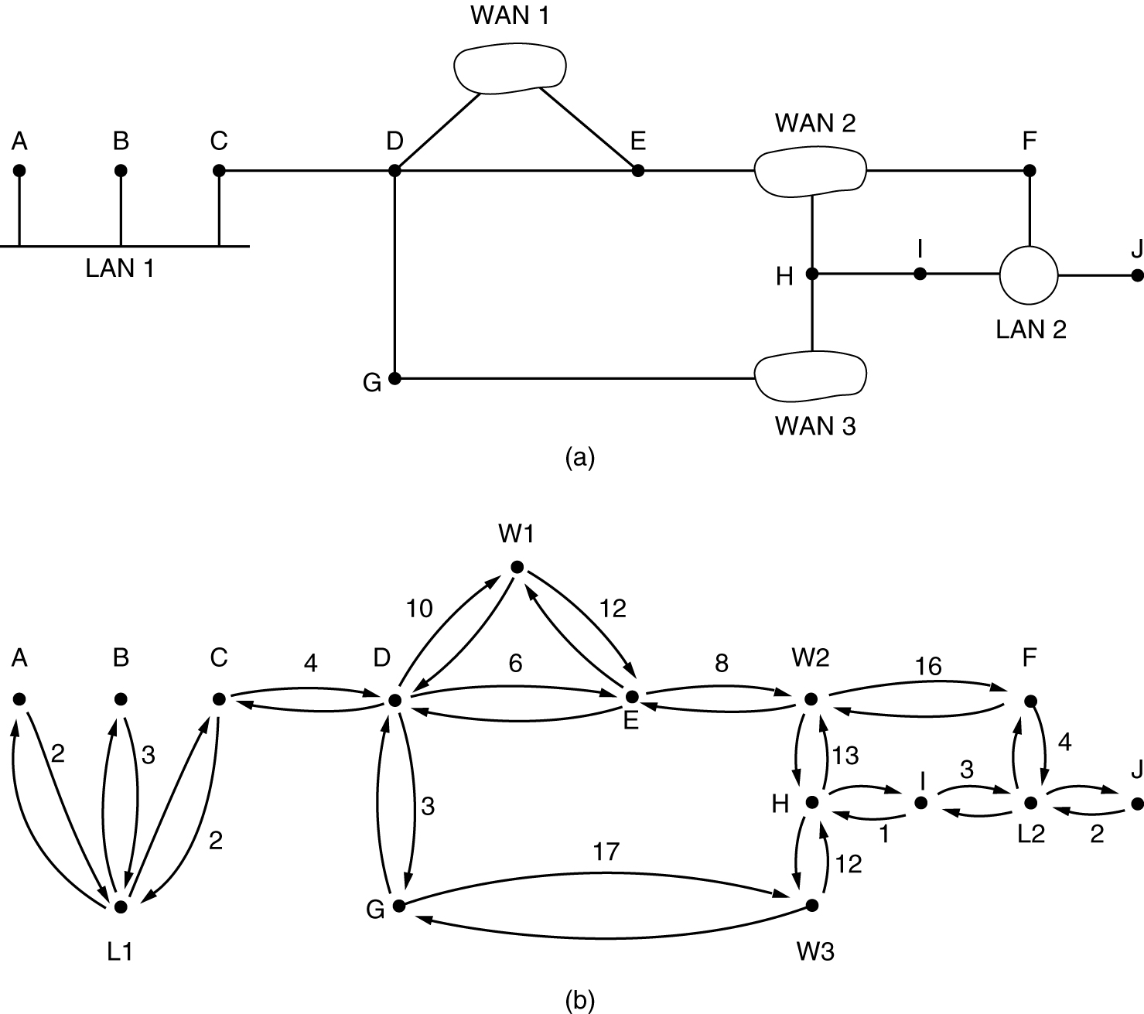
OSPF
AS containing all three kinds of networks
(a) An autonomous system. (b) A graph representation of (a).

Slide 31
Routing Algorithms - OSPF
OSPF operates by abstracting the collection of actual networks, routers, and lines into a directed graph in which each arc is assigned a cost (distance, delay, etc.).
It then computes the shortest path based on the weights on the arcs.
A serial connection between two routers is represented by a pair of arcs, one in each direction.
Their weights may be different.
A multiaccess network is represented by a node for the network itself plus a node for each router.
Weights are symmetric, unless marked otherwise.
What OSPF fundamentally does is
To represent the actual network as a graph like this and then compute the shortest path from every router to every other router.

Slide 32
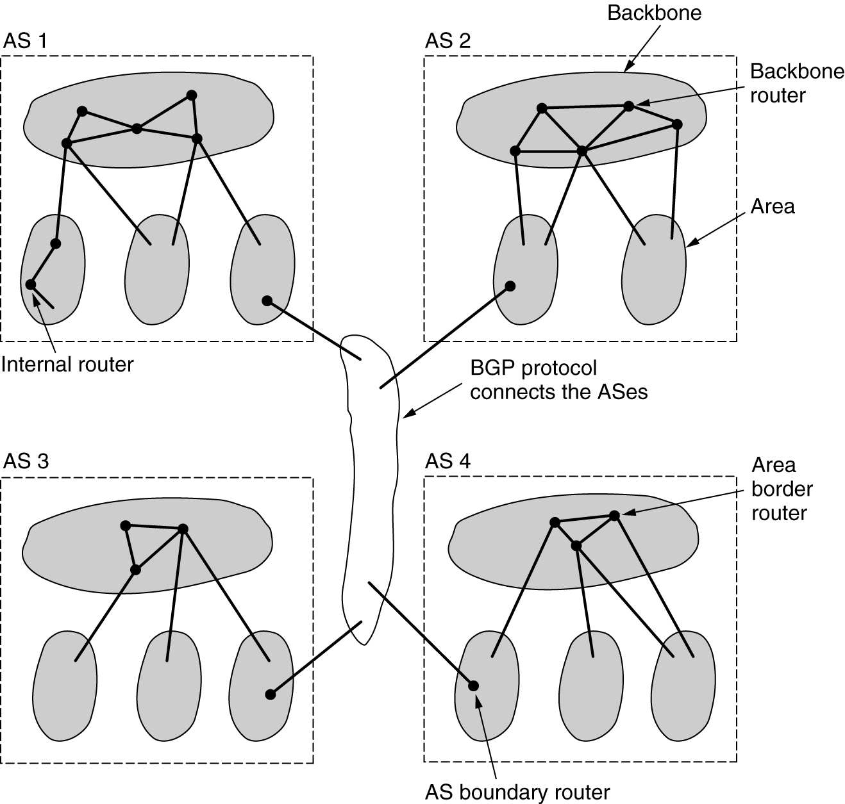
OSPF
The relation between ASes, backbones, and areas in OSPF.

Slide 33
Routing Algorithms - OSPF
Many of the ASes in the Internet are themselves large and nontrivial to manage.
OSPF allows them to be divided into numbered areas, where an area is a network or a set of contiguous networks.
Areas do not overlap but need not be complete, that is, some routers may belong to no area.
An area is a generalization of a subnet.
Outside an area, its topology and details are not visible.
Every AS has a backbone area, called area 0.
All areas are connected to the backbone
so it is possible to go from any area in the AS to any other area in the AS via the backbone.
Each router that is connected to two or more areas is part of the backbone.

Slide 34
Routing Algorithms - OSPF
Within an area, each router has the same link state database and runs the same shortest path algorithm.
Its main job is to calculate the shortest path from itself to every other router in the area, including the router that is connected to the backbone.
A router that connects to two areas needs the databases for both areas and must run the shortest path algorithm for each one separately.

Slide 35
Routing Algorithms - OSPF
OSPF distinguishes four classes of routers:
1. Internal routers are wholly within one area.
2. Area border routers connect two or more areas.
3. Backbone routers are on the backbone.
4. AS boundary routers talk to routers in other ASes.

Slide 36
Routing Algorithms - OSPF
Working:
When a router boots, it sends HELLO messages on all of its point-to-point lines and multicasts them on LANs to the group consisting of all the other routers.
From the responses, each router learns who its neighbors are.
Routers on the same LAN are all neighbors.
OSPF works by exchanging information between adjacent routers
In particular, it is inefficient to have every router on a LAN talk to every other router on the LAN.
To avoid this situation, one router is elected as the designated router.
It is said to be adjacent to all the other routers on its LAN, and exchanges information with them.

Slide 37
Routing Algorithms - OSPF
Neighboring routers that are not adjacent do not exchange information with each other.
A backup designated router is always kept up to date to ease the transition if the primary designated router crash and need to be replaced immediately.

Slide 38
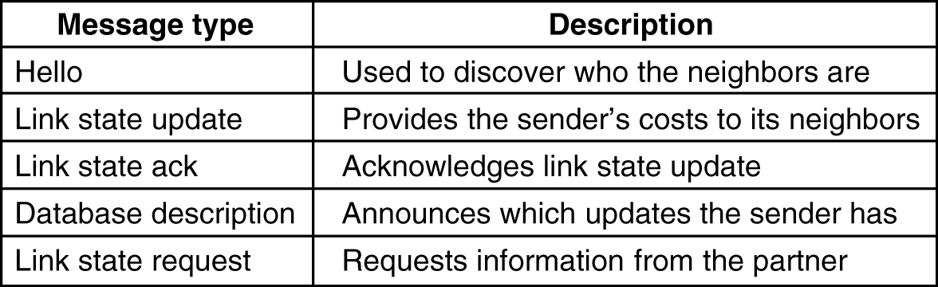
OSPF
The five types of OSPF messages.

Slide 39
Routing Algorithms - OSPF
OSPF sends Hello (greeting) messages on each link periodically to establish and test neighbour reachability
Database Description messages are exchanged by routers to initialize their network topology database.
After exchanging Database Description message, router may discover that some part of its database is outdated.
Link State Request message is used to request the neighbour to supply the updated information.
Routers broadcast the status of links with Link State Update message. Each update consists of a list of advertisements.
Link state acknowledgement message acknowledges the receipt of a Link State Update message.

Slide 40
Routing Algorithms - OSPF
Summary:
Using flooding, each router informs all the other routers in its area of its neighbors and costs.
This information allows each router to construct the graph for its area(s) and compute the shortest path.
The backbone area does this too.
In addition, the backbone routers accept information from the area border routers in order to compute the best route from each backbone router to every other router.
This information is propagated back to the area border routers, which advertise it within their areas.
Using this information, a router about to send an interarea packet can select the best exit router to the backbone.

